Slide 1
Rosewood Water Main Update
September 14th, 2023

Slide 2
Agenda
Introductions
Rosewood Drinking Water Project
Questions

Slide 3
Rosewood Project
The Rosewood Area Water System Improvements (WM3925) Project will install approximately 115,500 ft. of new water lines in the Rosewood area
Project is divided into three phases
Current budget estimates:
Phase 1: $12.0 million
Phase 2: $10.0 million
Phase 3: $11.9 million
Total: $33.9 million

Slide 4
Rosewood Project Schedule
Design Work Began: January 2021
Phase 1 is complete, Phase 2 at 90%, Phase 3 at 60%
Phase 1 Construction Start Date: Fall 2023
Phase 1 Construction Completion: Spring 2025
Work will be done by LAD Construction (Supervisor Ted Blackwell)
Phase 2 Construction Start Date: Spring 2024
Phase 2 Construction Completion: Fall of 2026
Phase 3 Construction Start Date: Fall 2024
Phase 3 Construction Completion: Spring 2027

Slide 5
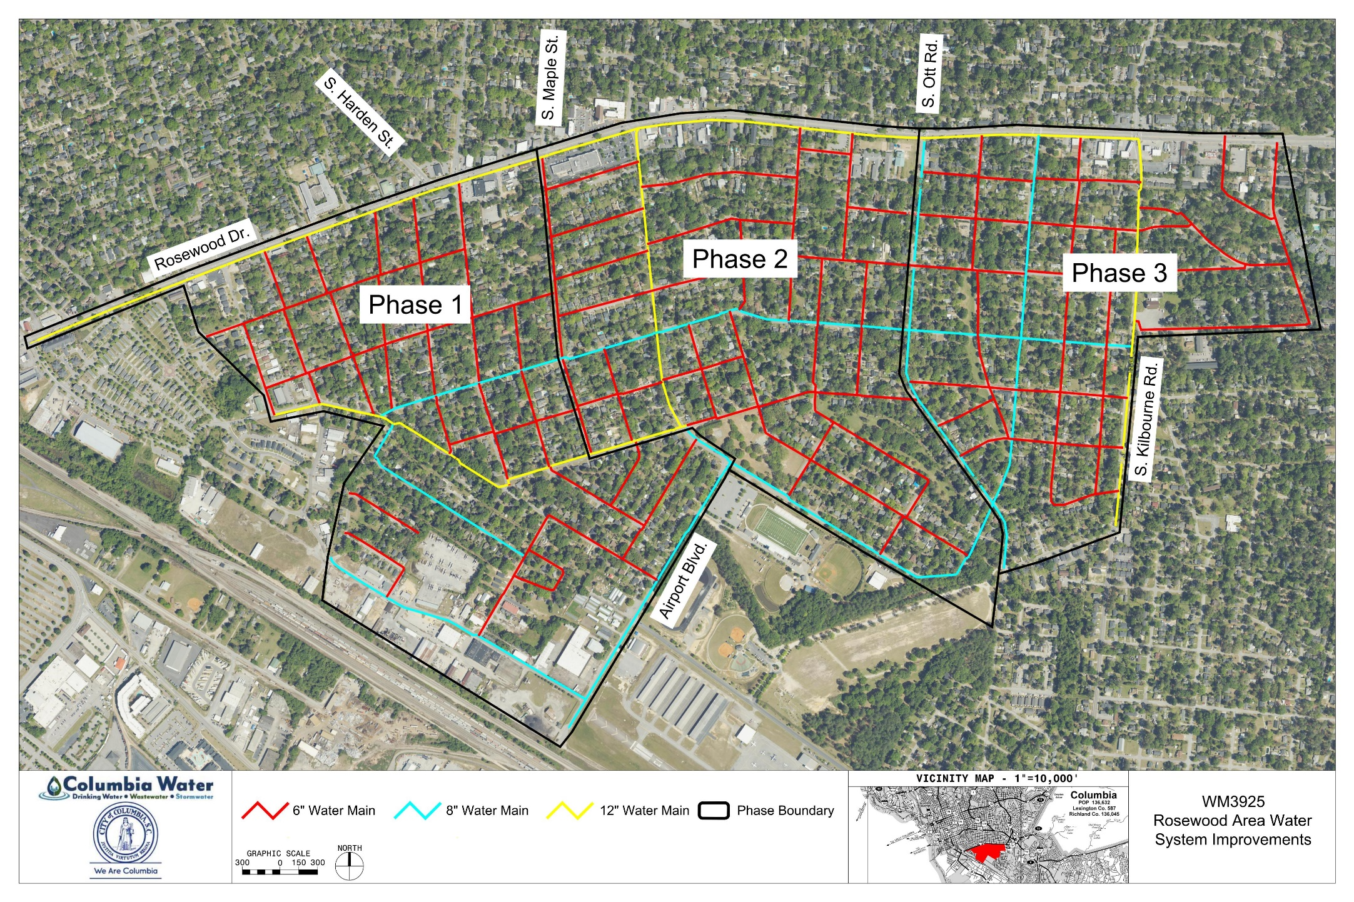
Rosewood Project Map

Slide 6
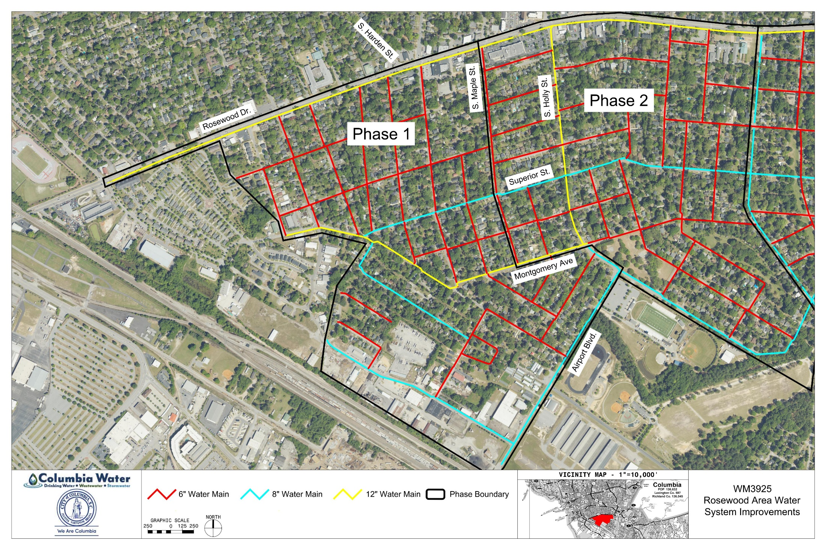
Phase 1
Phase 1 Schedule
Construction Start | Fall 2023
Construction End | Spring 2025

Slide 7
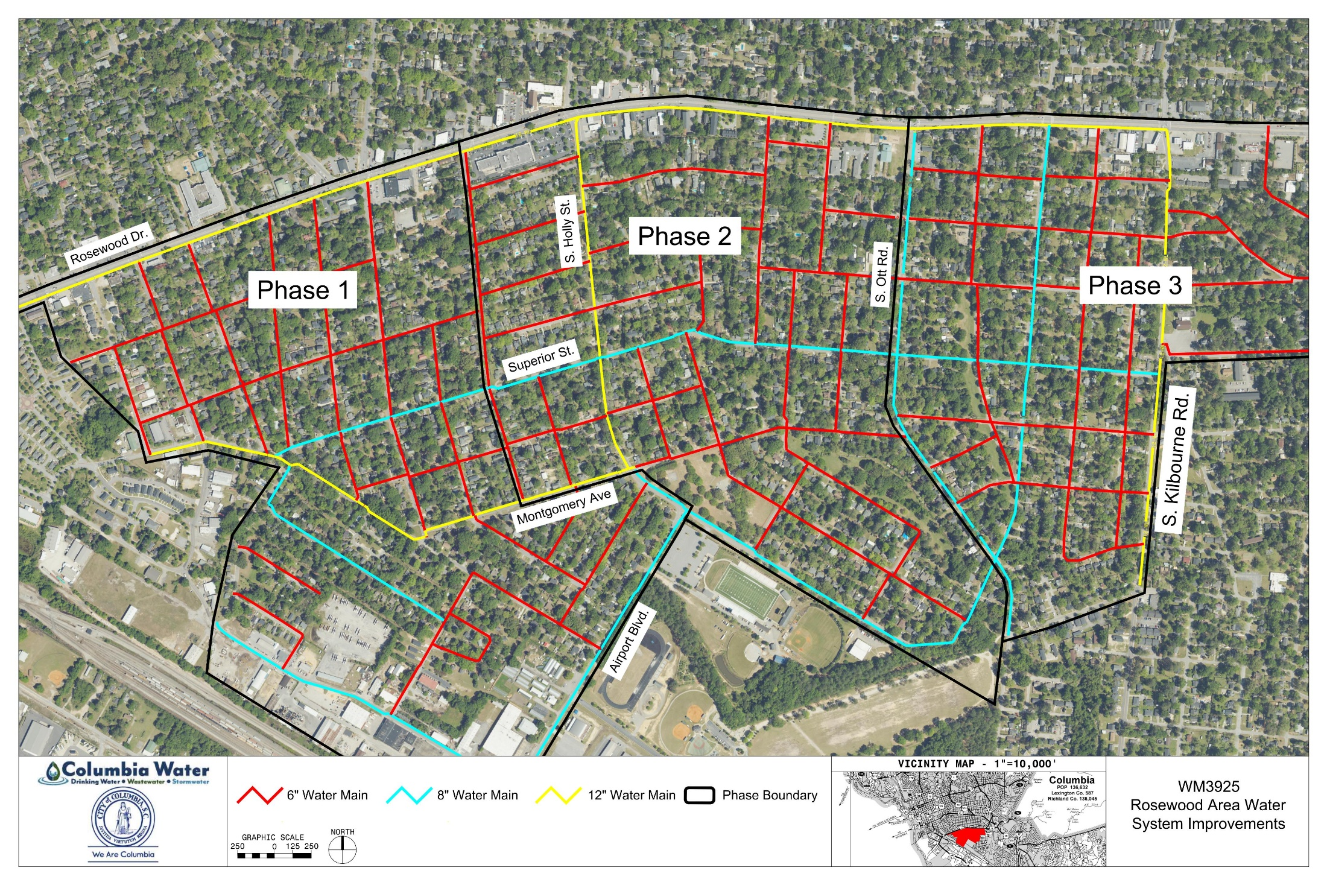
Phase 2
Phase 2 Schedule
Construction Start | Spring 2024*
Construction End | Fall 2026*
*Pending permitting

Slide 8
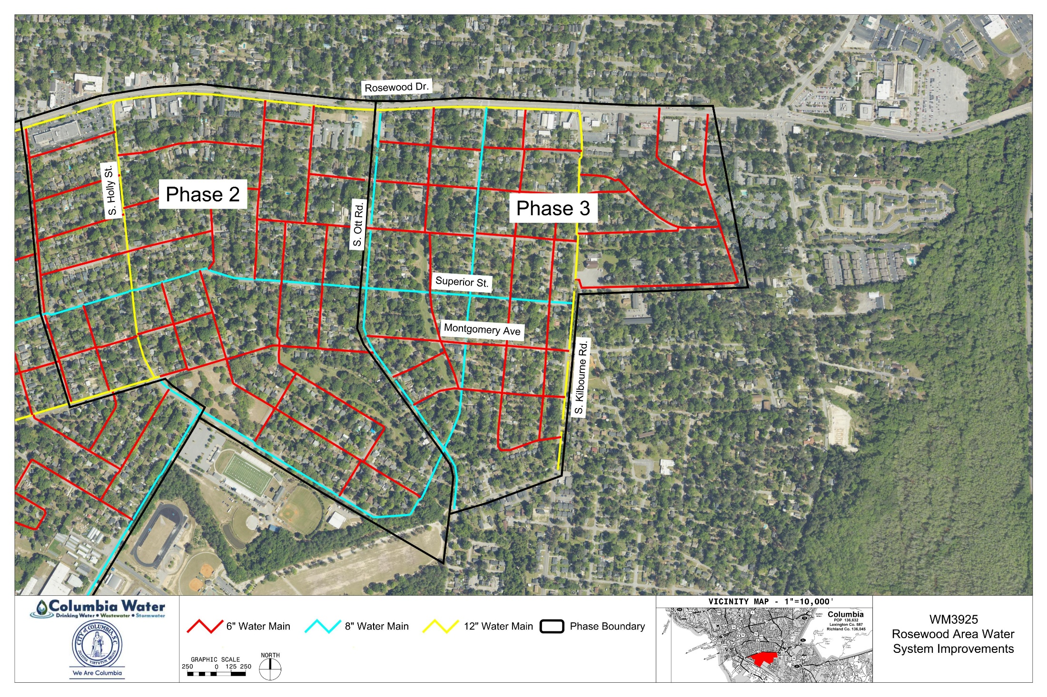
Phase 3
Phase 3 Schedule
Construction Start | Fall 2024*
Construction End | Spring 2027*
*Pending funding availability

Slide 9
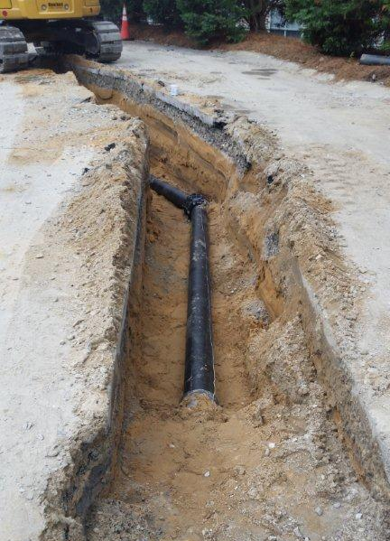
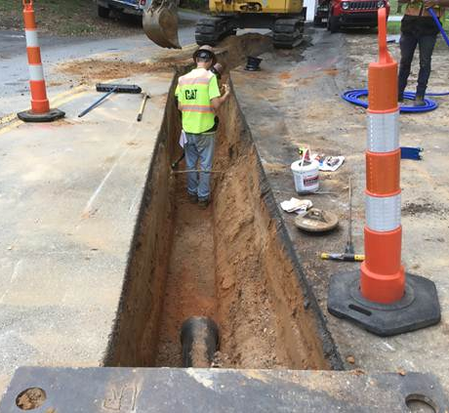
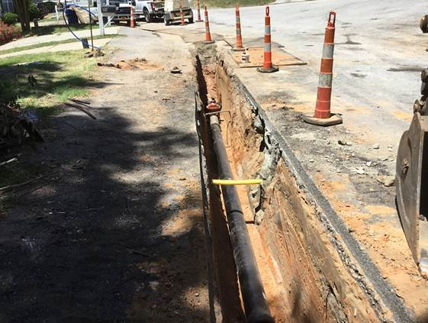
Water Line Construction
Water line construction is done in stages.
Temporary impacts to parking and driveway access
Road detours / limited through traffic
Items in ROW or front yards may be moved if they are blocking construction

Slide 10
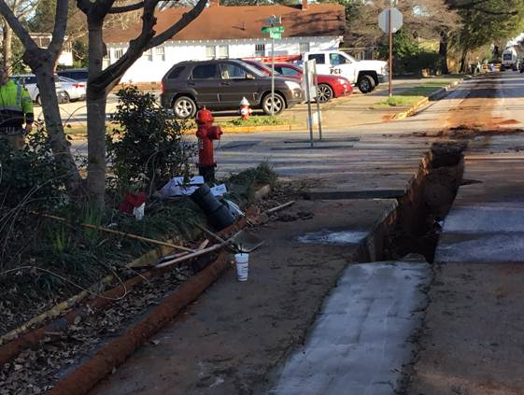
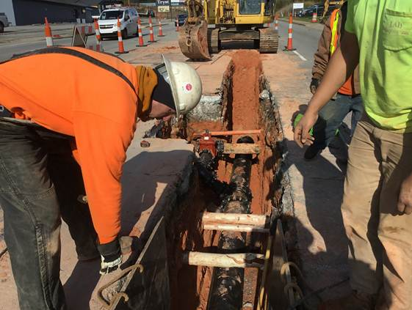
Water Line Construction
A few meter relocations / service interruptions
Relocation of inaccessible / odd sized meter boxes (AMI)
Relocation of any backyard meters to street side
Tie-in of new service connection to existing home service

Slide 11
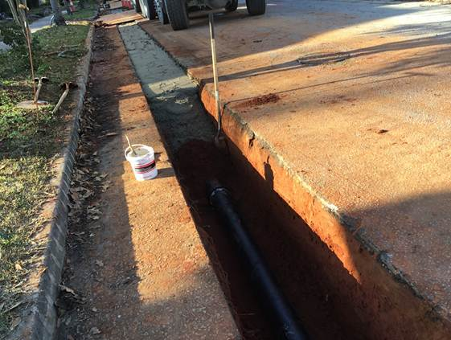
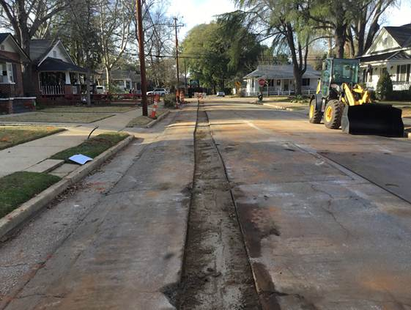
Water Line Construction
Backfill and Asphalt / Concrete Repair (35% of budget)
Most areas will be patch / repair of just the trench cut
Entire lane or intersection to be resurfaced in some areas
Especially on Rosewood Avenue

Slide 12
Post Construction
Once your water line has been tested and reconnected to your meter, you will have the recommended water pressure coming to your house
You may temporarily experience some discolored water due to debris that is knocked loose from the higher water pressure.
The City recommends running an external spigot or hose until the discoloration is gone to avoid clogging internal faucets with debris.

Slide 13
Questions/Discussion
City Inspector
Matt Blackwell
803-216-4590
Matthew.Blackwell@columbiasc.gov
Follow us on social media!
We are ColumbiaSCWater on Facebook, Twitter and Instagram.

